Slide 1


Middleware Review and Performance Evaluation
Summer 2019
Vanderbilt University
Dept of Electrical Eng & Comp Sc
Sagar Shah
Guided by:
Dr. Abhishek Dubey
Dr. Theodore Bapty

Slide 2

Internet of Things and Middleware
The middleware for IoT acts as a bond joining the heterogeneous domains of applications communicating over heterogeneous interfaces.

Slide 3

Goal
To compare and evaluate different middleware solutions depending upon requirements of a system.
There are several solutions available such as OPC UA, DDS, MQTT, RabbitMQ, Kafka, etc.
OPC UA
DDS
MQTT
RabbitMQ

Slide 4
Agenda
Middleware Qualitative Analysis
Background of the middleware literature for IoT
Middleware Quantitative Analysis

Slide 5
Qualitative Analysis – Middleware Literature Review OPC UA Pub/Sub, MQTT and DDS

Slide 6
Brief Introduction to Middleware
Communication Paradigms
Middleware variants
Requirements of Publish/Subscribe Middleware
Challenges

Slide 7
Communication paradigms
Publish/Subscribe
Message Passing
Remote Procedural Call
Notifications
Shared spaces
Message queuing
Notes:
Message passing - Producers and consumers are tied in time and space
RPC – CORBA, Microsoft DCOM..Clients make request for a particular service to the server and the server returns the answer
Notifications – Coupled in time and space
Shared spaces – Distributed Shared Memory; Provide time and space decoupling. Global data space
Message queuing – No synchronization decoupling

Slide 8
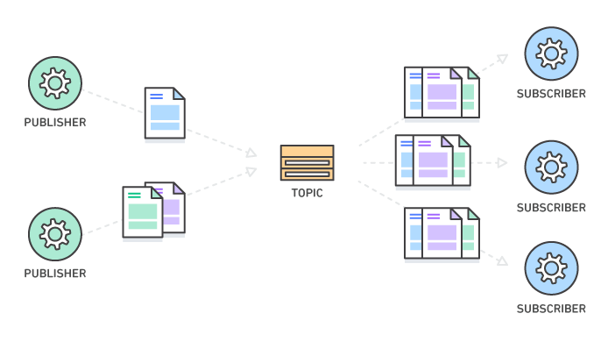
Requirements of a Publish/Subscribe Middleware
Space decoupling
Publishers and Subscribers do not need to know each other
Time decoupling
Publishers and Subscribers do not need to be active at the same time
Synchronization decoupling
Neither publishers nor subscribers block each other

Slide 9
Middleware variants
Types of Middleware
Message based
Architecture based
Subscription Model based
Message - centric
Content - centric
Topic – based
Content - based
Broker
Peer to Peer
Notes:
Data centricity, by contrast, makes the data the means of interaction. A data centric infrastructure must define the data it manages. Then, the infrastructure imposes rules that determine how data is structured, when data is changed, and how it is accessed. There is a notion of a "global data space", where data values, in known structures, are exchanged. The infrastructure is aware of the contents. With a data-centric approach, developers write applications that read and update entries in this data space Content- based subscription model - Notify me of all stock quotes of IBM from New York stock exchange if the price is greater than 150

Slide 10
Challenges
Middleware Challenges
Interoperability
Security
Quality of Service Management
Resource Management
Dynamic Discovery
Scalability
Notes:
Interoperability
-
Resource management
- With so many embedded devices available, available CPU and memory are limited which means middleware should provide mechanisms for efficient processor and memory use while enabling low-power communications.
Security
- Breach of security can be hazardous in healthcare industries. In a resource constrained environment, the traditional heavy weight security measures are unsuitable. Middleware should integrate security in the initial phases of software design, achieving security requirements such as confidentiality, authentication, integrity, freshness and availability.
Scalability
- Applications should be allowed to grow such that network performance is not affected.
Dynamic discovery
- As applications come and go, endpoints for communications should be easy to configure.

Slide 11
OPC UA PubSub

Slide 12
What is Open Platform Communications (OPC)?
According to OPC Foundation, “OPC is the interoperability standard for the secure and reliable exchange of data in the industrial automation space and in other industries. It is platform independent and ensures the seamless flow of information among devices from multiple vendors.”
OPC addresses issues like:
Proprietary Protocol
Custom Drivers
Complex Integration
Device and Controller loading
Outdated Infrastructure
Enterprise Wide Data Connectivity
Evolution of OPC
Classic OPC
OPC UA
OPC UA PubSub

Slide 13
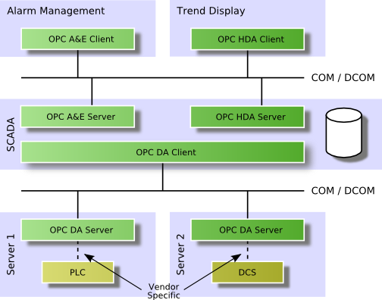
OPC Classic
The OPC Classic is a set of specifications based on COM/DCOM (Distributed Component Object Model) for the exchange of data between software components.
Three specifications describes way to access process data, alarms and historical data.
OPC Data Access
Defines the exchange of data including values, time and quality information.
OPC Alarms and Events
Defines the exchange of alarm and event type message information, as well as variable states and state management.
OPC Historical Data Access
Defines query methods and analytics that may be applied to historical, time-stamped data.

Slide 14
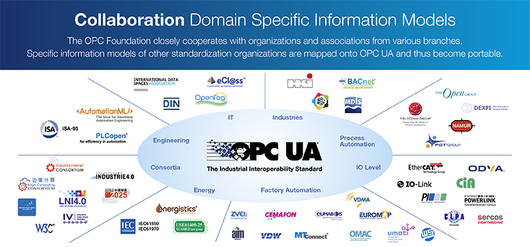
What is OPC UA?
The OPC Unified Architecture (UA) is a platform independent service-oriented architecture provides a machine to machine communication protocol to transfer data.
OPC UA
Platform for implementing secure end-to-end data exchange between third party systems
Facilitates interoperability between third-party devices and applications.
Rich data modeling capabilities
Device-centric approach
Widely adopted, especially in manufacturing industry
Notes:
Data modeling - Data model emphasizes on what data is needed and how it should be organized instead of what operations need to be performed on the data.
Address space – Collection of the information that a server makes visible to its clients.

Slide 15
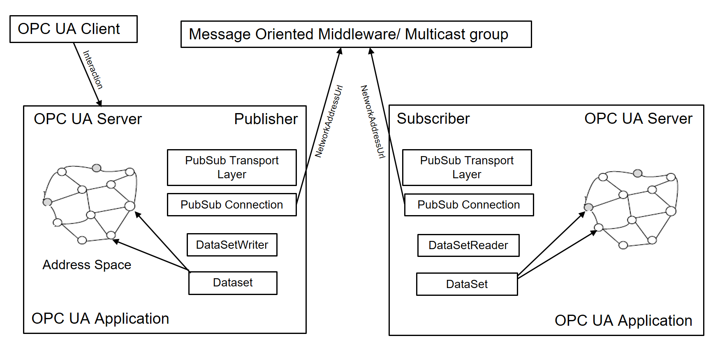
Why OPC UA PubSub was introduced?
PubSub enables the use of OPC UA directly over the Internet (Wide Area Networks) by utilizing popular data transports like MQTT and AMQP while retaining its key OPC UA end-to-end security and standardized data modeling advantages.
PubSub also enables use of the User Data Protocol (UDP) for establishing low-latency, loss tolerating connections on LANs.
Based on image from opcfoundation.org

Slide 16
OPC UA – Message Lifecycle
Publisher
Subscriber

Slide 17
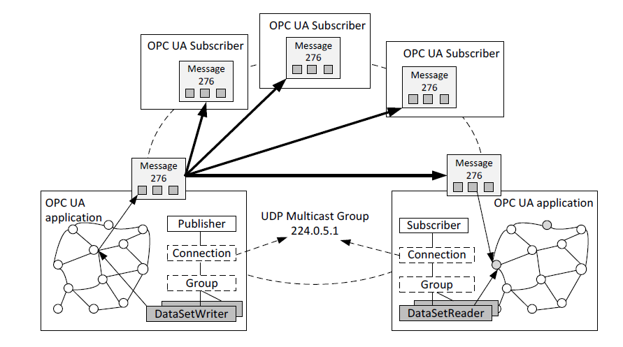
OPC UA -Broker-less
The broker-less variant, the one that we are using relies on the network infrastructure to deliver Network Messages
Broker-less model overview

Slide 18
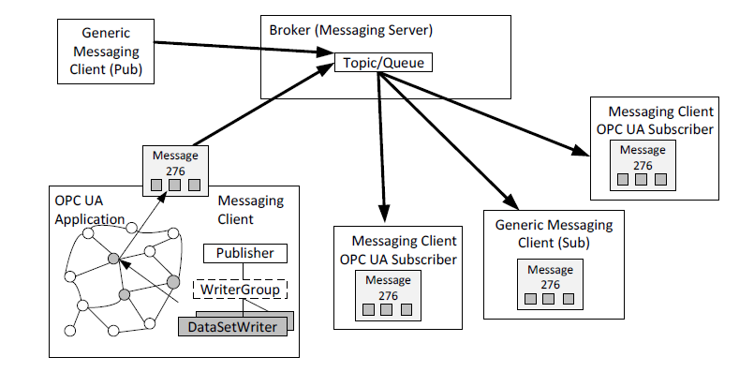
OPC UA - Broker-based
A broker based model requires use of messaging protocols that a broker understands, like AMQP or MQTT.
QoS:
RequestedDeliveryGuarantee BrokerTransportQualityofService parameter can be specified for different delivery guarantees that will apply to all the NetworkMessages:
BestEffort_1
AtLeastOnce_2
AtMostOnce_3
ExactlyOnce_4
Broker model overview

Slide 19
OPC UA – Configuration Options
Message Configuration Options
Encoding
QoS
Broker - less
UADP Messages over UDP
UADP Messages over Ethernet
Broker
UADP Messages over AMQP
UADP Messages over MQTT
JSON Messages over AMQP
JSON Messages over MQTT
OPC UA Binary – High Performance
OPC UA JSON – Supports interoperability
OPC UA XML – used for web services
AMQP
AtMostOnce_1
AtLeastOnce_2
ExactlyOnce_3
MQTT
AtMostOnce_1 is mapped to MQTT QoS 0.
AtLeastOnce_2 is mapped to MQTT QoS 1.
ExactlyOnce_3 is mapped to MQTT Qos 2.
Notes:
OPC UA Ethernet – A simple Ethernet based protocol that is used to transport UADP NetworkMessages as payload of the Ethernet II frame without IP or headers.

Slide 20
MQTT

Slide 21
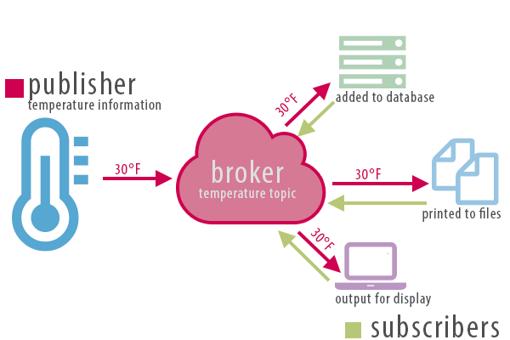
What is MQTT?
MQTT is a machine to machine protocol focused on the interoperable exchange of messages and is designed to be open, simple, lightweight and easy to implement.
MQTT characteristics:
Low overhead (2 bytes header)
Message centric / Data agnostic
Centralized
Built on top of TCP

Slide 22
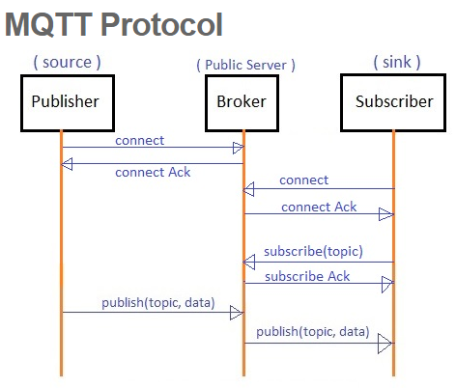
Key MQTT Entities
The core components of MQTT are clients, brokers, sessions, subscriptions and topics.
Clients
Any device that runs an MQTT library and connects to an MQTT broker over a network.
Broker
Receives all the published messages, filters them based on topic and sends them to subscribed clients based on their interest
Sessions
MQTT client’s ongoing connection with a MQTT broker. Sessions can be persistent.
Topics
Form of addressing that allows MQTT clients to share information and filter messages for each client.
Notes:
Why MQTT isn’t a message queue?

Slide 23
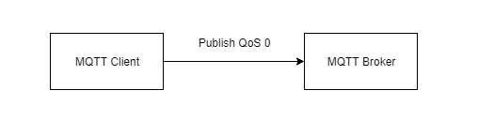
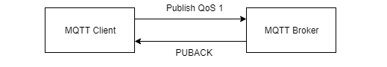
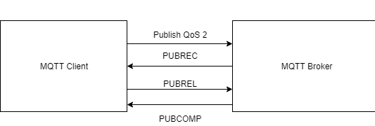
Quality of Service
There are three QoS levels in MQTT
At most once (0)
Guarantees a best-effort delivery
At least once (1)
Guarantees the message is delivered at least one time to the receiver
Exactly once (2)
Guarantees the message is received only once by the intended recipients

Slide 24
DDS

Slide 25
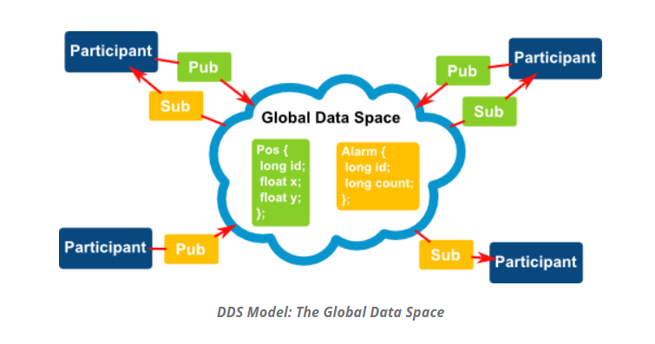
What is DDS?
DDS is a machine-to-machine standard that aims to enable dependable, high-performance, interoperable, real-time, scalable data exchanges using a publish subscribe pattern.
DDS defines a Data-Centric Publish Subscribe model for communication between distributed applications.
The focus is on the distribution of data between communicating applications
As per the DCPS approach, DDS has a notion of a global data space which means the infrastructure is aware of the components.
The applications can read and update entries the global data space
Source: Based on slides from Dr. Abhishek Dubey
Notes:
Data centric vs Object Centric middleware: In data-centric communications, the focus is on the distribution of data between communicating applications. A data-centric system is comprised of data publishers and data subscribers. In object-centric communications the fundamental concept is the interface between the applications. An interface is comprised of a set of methods of known types (number and types of method arguments). An object-centric system is comprised of interface servers and interface clients, and communications are based on clients invoking methods on named interfaces that are serviced by the corresponding server.

Slide 26
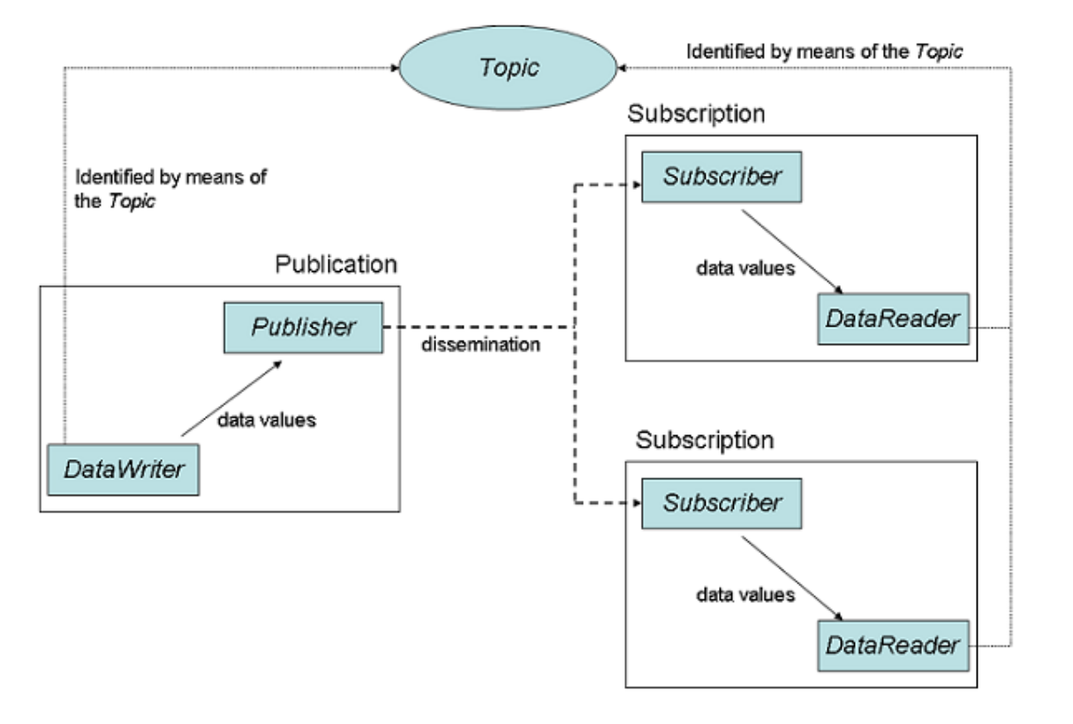
Key DDS Entities
Domain
Domain Participant
Topic
Publisher
Data Writer
Subscriber
Data Reader

Slide 27
QoS Policies - DDS
Different policies
Liveliness
Reliability
History
Durability
Durability_Service
Resource_Limits
Partition
Deadline
Lifespan
Time_Based_Filter
Ownership
User_Data
Topic_Data
Group_Data
Transport_Priority
Latency_Budget
Entity_Factory
Presentation
Destination_Order
Writer_Data_Lifecycle
Reader_Data_Lifecycle
Ownership_Sthrength

Slide 28
Quick Summary
Comparison Criteria | OPC UA | MQTT | DDS
Messaging Pattern | Client/Server Publish/Subscribe | Publish/Subscribe | Publish/Subscribe
PubSub Variation | Transport layer dependent | Topic – based | Topic – based
Architecture | Broker Broker-less | Broker | Peer-Peer
Transport | TCP | Built on top of TCP/IP | Default – UDP TCP support available
Centricity | Object – Centric | Message - centric | Data - centric
Interoperability | Yes | Partial | Yes

Slide 29
Quick Summary
Comparison Criteria | OPC UA PubSub |  | MQTT | DDS
QoS Properties | Requested Delivery Guarantee for Broker-based Transport |  | QoS 0 – Atmost once, QoS 1 – Atleast once QoS 2 – Exactly once | reliability, history, lifespan, durability, liveliness, ownership, deadline
 | AMQP | MQTT
 | AtMostOnce AtLeastOnce ExactlyOnce | AtMostOnce AtLeastOnce ExactlyOnce
Message Encoding format | OPC UA Binary, OPC UA XML and OPC UA JSON |  | Binary | OMG IDL - CDR
Discovery | Explicit search. Requires programmatic effort |  | No built – in support. Plugins available | Dynamic Peer to Peer/Federated Discovery
Encryption / Security Support | Uses a separate Security Key Server. Publishers and Subscribers provide their credentials and in return receive the decryption keys |  | Authentication – user name / password, OAuth, Certification Encryption – TLS/SSL | Supported by Connext DDS Secure​
License | Implementation License: MIT, GPLv2, RCL |  | Implementation specific. Paho MQTT – Eclipse Public License 1.0 | Professional and Free Trial

Slide 30
Performance Evaluation of Middleware OPC UA Pub/Sub, DDS and MQTT

Slide 31
Experiment Setup
Machine - Raspberry Pi 3, Model B
ARM Cortex A7 processor
Cores – 4
RAM – 1 GB
100 Mbps network switch – Star Topology
Evaluation Scenarios
1 Publisher – 1 Subscriber
1 Publisher – Many Subscriber
Time Synchronized
Precision Time Protocol

Slide 32
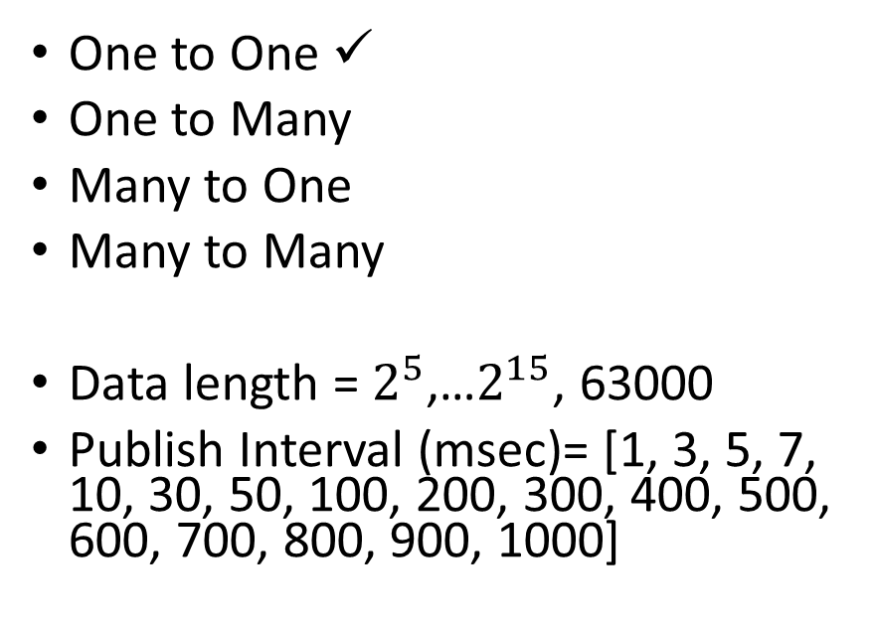
Performance Measure
Evaluation Scenarios
Throughput
Messages/Sec ✓
Mbps ✓
Latency
One way latency ✓
Jitters
Publisher and Subscriber
One to One ✓
One to Many
Many to One
Many to Many
Data length = $2^{5}$,…$2^{15}$, 63000
Publish Interval (msec)= [1, 3, 5, 7, 10, 30, 50, 100, 200, 300, 400, 500, 600, 700, 800, 900, 1000]

Slide 33
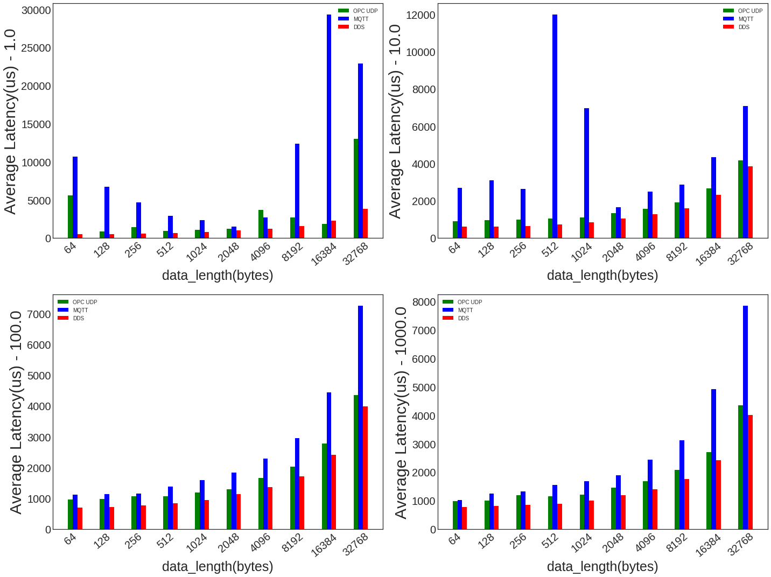
Application Latency vs Packet Size
DDS’ performance across all the intervals is the best.
OPC UDP’s performance is comparable but slightly lower than that of DDS.

Slide 34
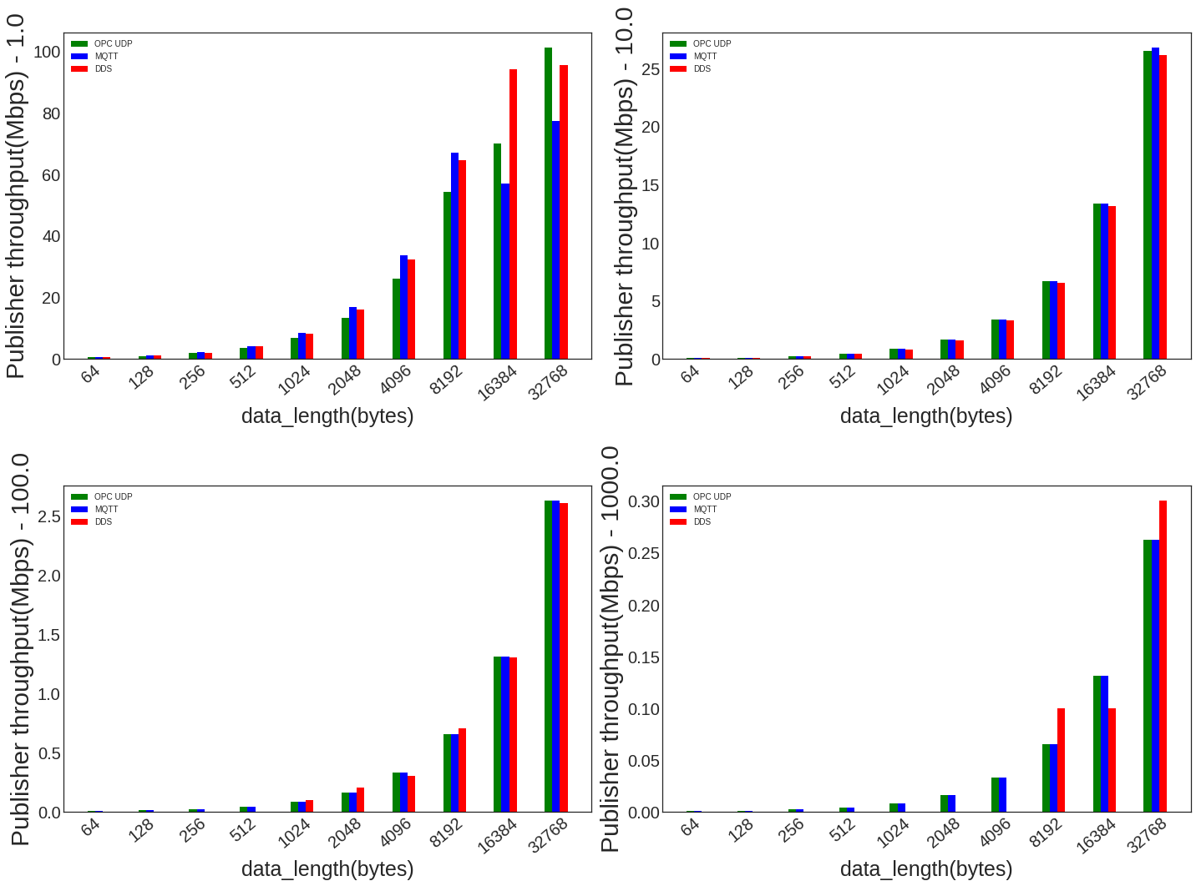
Publisher Throughput vs Packet Size (Mbps)

Slide 35
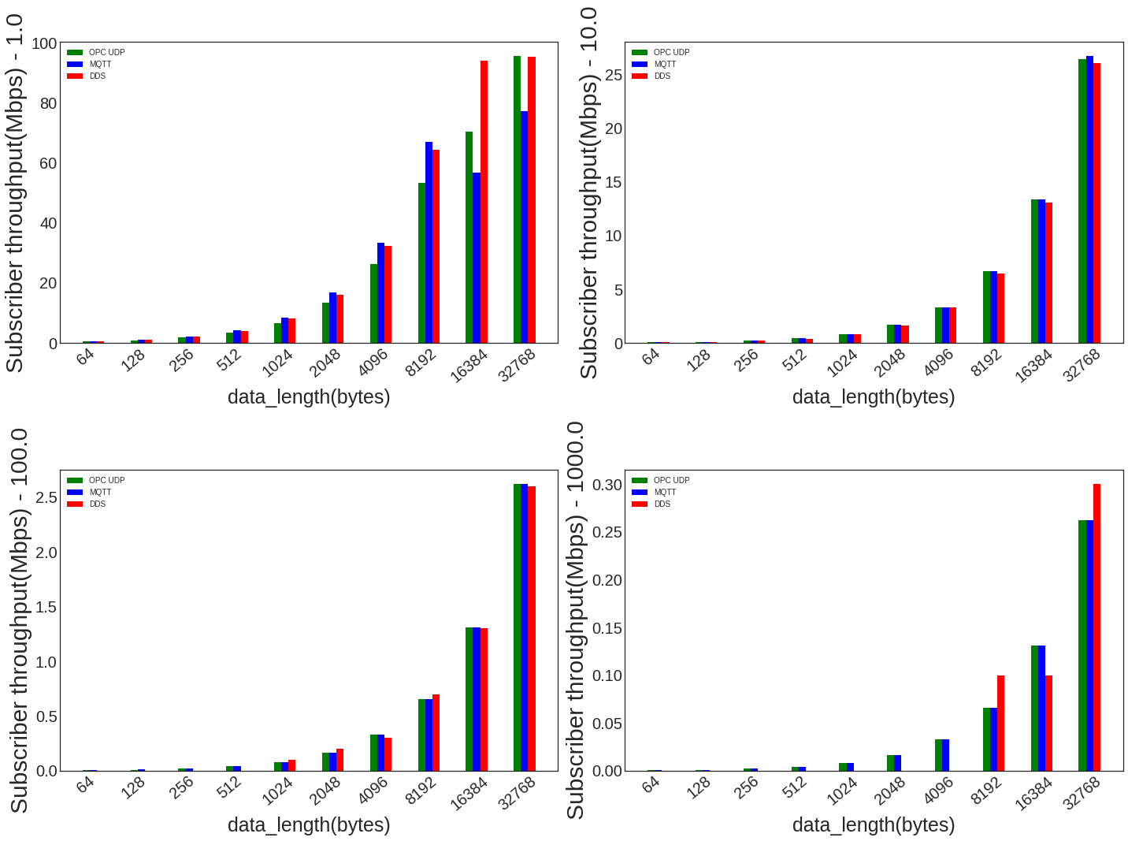
Subscriber Throughput vs Packet Size (Mbps)
- DDS’ lives up to its claim of highest performing

Slide 36
Classes of Applications | Comparison Criteria | OPC UA UDP | MQTT | DDS
Low Payload and Low Publishing rate | Latency | Better | Worst | Best
 | Throughput | Similar to MQTT | Similar to OPC UA UDP | Worst
Low Payload and High Publishing rate | Latency | Comparable to DDS | Worst | Best
 | Throughput | Worst | Best | Comparable to DDS
High Payload and Low Publishing rate | Latency | Comparable to DDS | Worst | Best
 | Throughput | Similar to MQTT | Similar to OPC UA UDP | Best
High Payload and High Publishing rate | Latency | Better | Worst | Best
 | Throughput | Best | Worst | Better

Slide 37
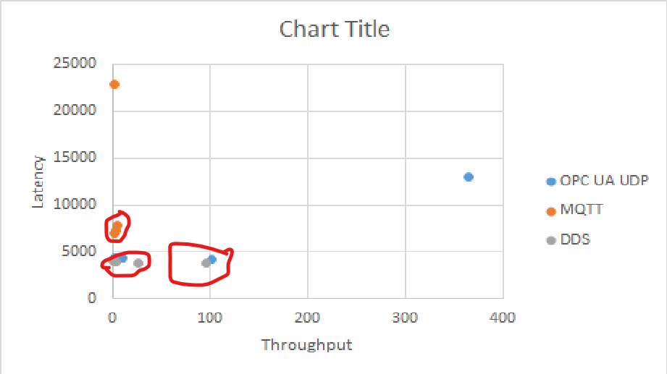
Future Work – Middleware Recommendation System (MRS)
A middleware recommendation system ranks and returns, based on a system’s requirements such as publishing rate, data volume, performance budget (like latency, throughput, jitter), footprint (like memory utilization, CPU utilization, network utilization) and multiple other factors, a list of middleware that closely fits it.
Latency vs Throughput
User input
Recommender Function
Middleware Prediction

Slide 38
Challenges and what do we have?
Datasets
Choice of the model
Notion of the closest
Incorporating scalability
User space
QoS
Publishing Rate
Data volume
Participating Entities
Number of publishers
Number of subscribers
Performance budget
System budget
CPU utilization
Memory utilization
Bandwidth utilization
Output Space
Latency
Throughput
Packet loss
Jitter

Slide 39
Summary and Conclusion
Performance requirements of an application are context driven
There is no one size fits all solution
As a challenge, how to quantify qualities of middleware
Collect and collect more data
Possibly develop a system that provides recommendation

Slide 40
Acknowledgements
Zhuangwei Kang, PhD Student, Vanderbilt University
Robert Canady, PhD Student, Vanderbilt University

Slide 41
Citations
T. Oberstein, A. Goede and Tavendo, "draft-oberstet-hybi-tavendo-wamp-02," 11 July 2015. [Online]. Available: https://tools.ietf.org/html/draft-oberstet-hybi-tavendo-wamp-02. [Accessed 28 July 2019].
S. Aiyagari, S. Sadjadi, M. Arrot, R. Schloming, M. Atwell, S. Shaw, J. Brome, G. Sim, A. Conway, M. Sustrik, R. G. C. Trieloff, P. Hintjens, K. v. d. Riet, J. O'Hara, S. Vinoski and M. Ritchie, "AMQP Advanced Message Queuing Protocol Specification," December 2006. [Online]. Available: https://www.rabbitmq.com/resources/specs/amqp0-9.pdf. [Accessed 30 July 2019].
HiveMQ, "MQTT Essentials - All Core Concepts explained," [Online]. Available: https://www.hivemq.com/mqtt-essentials/. [Accessed 30 July 2019].
A. Banks and R. Gupta, "[mqtt-v3.1.1]," 29 October 2014. [Online]. Available: http://docs.oasis-open.org/mqtt/mqtt/v3.1.1/os/mqtt-v3.1.1-os.html. [Accessed 28 July 2019].
S. Z, H. K and B. C, "The Constrained Application Protocol (CoAP)," June 2014. [Online]. Available: https://tools.ietf.org/html/rfc7252. [Accessed 30 July 2019].
P. Hintjens, "ZMQ Guide," [Online]. Available: http://zguide.zeromq.org/page:all. [Accessed 28 July 2019].
OPC Foundation, "OPC Foundation Unified Architecture Pub Sub," [Online]. Available: https://opcfoundation.org/developer-tools/specifications-unified-architecture/part-14-pubsub. [Accessed 30 July 2019].
OPC Foundation, "OPC Unified Architecture Specification Part 14: PubSub Release 1.04," OPC Foundation, 2018.
Unified Automation, "Discovery and Security Configuration," [Online]. Available: https://documentation.unified-automation.com/uasdkhp/1.0.0/html/_l2_ua_discovery_connect.html. [Accessed 16 August 2019].

Slide 42
M. Reiferson and J. Czebotar, "NSQ Docs 1.1.0 - A realtime distributed messaging platform," bitly, [Online]. Available: https://nsq.io/overview/quick_start.html. [Accessed 30 July 2019].
Cloud Native Computing Foundation, Synadia, "NATS," [Online]. Available: https://nats-io.github.io/docs/. [Accessed 29 July 2019].
Lightbend.com, "Getting Started Guide," Lightbend, [Online]. Available: https://doc.akka.io/docs/akka/current/guide/index.html. [Accessed 30 July 2019].
Real Time Innovations, "RTI Connext DDS Core Libraries User's Manual Version 5.2.3," Real Time Innovations.
A. Aslam, "Guest Post: Micro on NATS - Microservices with Messaging," 11 April 2016. [Online]. Available: https://nats.io/blog/microonnats/. [Accessed 29 July 2019].
Unified Automation, "Introduction to Classic OPC," [Online]. Available: http://documentation.unified-automation.com/uasdkhp/1.0.0/html/_l2_classic_opc.html. [Accessed 08 August 2019].
National Instruments, "Why OPC UA matters," 14 March 2019. [Online]. Available: https://www.ni.com/en-us/innovations/white-papers/12/why-opc-ua-matters.html. [Accessed 19 August 2019].

Slide 43


Slide 44
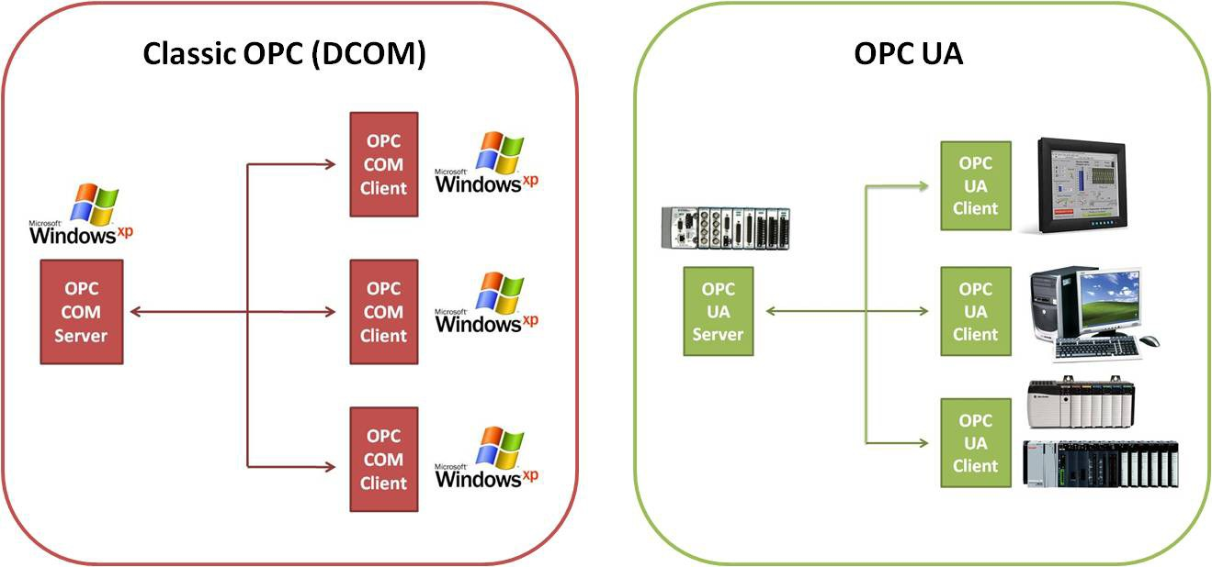
OPC UA Classic to Unified Architecture
The classic OPC was designed as an interface to communication drivers, allowing a standardized read and write access to current data in automation devices.
Platform Independence
One major limitation was platform dependence on Windows with COM being used in OPC.
Firewall
Classic is built on top of DCOM which in turn uses RPC.
RPC by default uses dynamic port allocation meaning large range of ports need to be opened raising security risks
OPC UA defines fixed ports for a communication channel
Data modeling capabilities
Common model for all OPC data
Complex data and methods
Scalability from simple to complex models
Notes:
TODO: Find out firewall issues

Slide 45
Domain and Domain Participant
Domain
Fundamental partitioning unit within DCPS
Each of the other entities belongs to a domain
Entities in same domain interact with each other
Application code is free to interact with multiple domains
Create multiple domain participants
One domain participant per domain
Domain Participant
Entry-point for an application to interact within a particular domain
Factory for many of the objects involved in writing or reading data

Slide 46
Topic
Topic
Unit of information
Fundamental means of interaction between publisher and subscriber
Assigned to data writers and readers
Within a domain, each topic has
A unique name
Data type
Associated QoS

Slide 47
Publisher and DataWriter
DataWriter
Used by the publishing application code to pass values (that are to be published) to the DDS middleware
Each data writer is bound to a particular topic
Responsible for marshaling the data and passing it to the publisher for transmission
Publisher
Responsible for disseminating published data to all relevant subscribers in the domain
Publishers owns a datawriter
Notes:
When a write function is called by a datawriter object the values are passed to the publisher object which does the actual dissemination of the data on the network.

Slide 48
Subscriber and DataReader
Subscriber
Receives the data from the publisher
Passes data to any relevant data readers
DataReader
Performs following actions
Takes data from the subscriber
Demarshals it into the appropriate type based on topic
Delivers the sample to the application
Each data reader is bound to a particular topic
The application uses the data reader’s type-specific interfaces to receive the samples

Slide 49
QoS Policies – Liveliness (DDS)
Controls when and how the service determines whether participants are alive (reachable)
Different kinds
AUTOMATIC_LIVELINESS_QOS
The service will automatically send a liveliness indication if the participant has not sent any network traffic for a certain amount of time
MANUAL_BY_TOPIC_LIVELINESS_QOS
Related entity (DataWriter) must either write a sample or manually assert its liveliness within a specified heartbeat interval
MANUAL_BY_PARTICIPANT_LIVELINESS_QOS
Same as above except related entity is DomainParticipant

Slide 50
QoS Policies – Reliability (DDS)
Controls how data readers and writers treat the data samples they process
Different kind
BEST_EFFORT_RELIABILITY_QOS
Makes no promises as to the reliability of the samples and could be expected to drop samples under some circumstances
RELIABLE_RELIABILITY_QOS
Service should eventually deliver all values to eligible data readers

Slide 51
QoS Policies – History (DDS)
Determines how samples are held in the data writer and data reader for a particular instance
Different kind:
KEEP_ALL_HISTORY_QOS
Specifies that all possible samples for a certain instance should be kept
Restricted by resource limit
KEEP_LAST_HISTORY_QOS
Specifies that only a certain number (depth) samples of a given instance should be kept
If depth == 1, just keep the last sample

Slide 52
QoS Policies – Durability (DDS)
Controls whether data writers should maintain samples after they have been sent to known subscribers
Different kind:
VOLATILE_DURABILITY_QOS
Samples are discarded after being sent to all known subscribers
TRANSIENT_LOCAL_DURABILITY_QOS
Data readers that are associated/connected with a data writer will be sent all of the samples in the data writer’s history
TRANSIENT_DURABILITY_QOS
Samples outlive a data writer and last as long as the process is alive
Samples are kept in memory only (not in persistent storage)
Unlike TRANSIENT_LOCAL_DURABILITY_QOS, late joining readers will receive all history
PERSISTENT_DURABILITY_QOS
Same functionality as transient durability except the cached samples are persisted and will survive process destruction
Late joiners will receive all history

Slide 53
QoS Policies – Deadline (DDS)
Allows the application to detect when data is not written or read within a specified amount of time period
By default period is infinity (no deadline!)
If period set to finite number and if it is missed, appropriate callbacks are invoked
Data writer: on_offered_deadline_missed()
Data reader: on_requested_deadline_missed()

Slide 54
Qualitative Comparison
Qualitative Comparison of Middleware
 | WAMP [1] | AMQP/RabbitMQ [2] | MQTT [3] [4] | CoAP [5] | ZeroMQ [6] |  | OPC UA PubSub [7] [8, 9] | NSQ [10] | NATS Messaging [11] |  | DPS [12] | DDS [13]
Messaging Pattern | 1. Pub/Sub 2. Routed Remote Procedure Calls – rRPC | Pub/Sub | 1. Pub/Sub 2. Request/Reply (in v 5.0) | 1. Request/ Reply 2. Pub/Sub | Client/Server Pub/Sub Push/Pull PAIR |  | Client/Server Pub/Sub | Pub/Sub | Pub/Sub Request/Reply Distributed Queuing |  | Pub/Sub | Pub/Sub Request/Reply
PubSub variation | Topic-based | Exchanges, Queues and Bindings | Topic - based | Topic – based | Message – based |  | Transport layer dependent | Topic and Channel - based | Subject- based |  | Topic-based | Topic – based
Implementation Style (Architecture) | PubSub – Broker RPC – Dealer | Broker based, peer-peer | Broker based | Client/Server Model PubSub – Broker | Implementation Specific |  | PubSub – Broker, Brokerless | Peer-Peer | Broker-based (NATS Server) |  | Actor-based (Actor acts as a broker/ registry)?? | Peer-Peer
Discovery |  | Config file, Preconfigured DNS A/AAAA records. AWS (EC2), Kubernets, Consul and etcd available as plugins. (RabbitMQ specific) | No built – in support. Plugins available. | End point, Resource-directory, Multicast based | Implementation specific. For e.g., hard-coded endpoint strings, message broker, address broker |  | Explicit Search. Requires programmatic effort. | Built-in discovery nsqlookupd | Client discovery | Server – Server discovery | Built-in: Config file, DNS, Aggregate Supported plugins: Kubernetes, AWS, Consuland Marathon APIs | Dynamic Discovery
 |  |  |  |  |  |  |  |  | User defined. Plugins available. [14] | Information of a connection made to a new server is propagated to all the servers in the NATS cluster
Transports | WebSockets (default), full-duplex single TCP connection | TCP/IP | MQTT protocol built on top of TCP/IP. MQTT over websockets. (Support only in JavaScript) | UDP (default), TCP and SCTP. | Unicast | Multicast | TCP, HTTP | TCP | Client-Server protocol | Server-Server protocol | UDP, TCP | UDP – Default, TCP
 |  |  |  |  | inproc, ipc and tcp | epgm, pgm
 |  |  |  |  |  |  |  |  | NATS Protocol | NATS Cluster Protocol
Interoperability |  | Yes | Yes | Yes | Yes |  | Yes | Partial | Yes |  |  | Yes
Data-Centric or Message Centric | Message – centric | Message - centric | Message - centric | Message - centric | Message – centric |  | Object - Centric | Message - centric | Message - centric |  | Message – centric | Data centric
QoS support |  | N/A | QoS 0 – Atmost once, QoS 1 – Atleast once QoS 2 – Exactly once | Messages can be marked as Confirmable , Non-confirmable | N/A |  | Broker_based_Transport_QoS | At least once - default | At most once (NATS Core) |  | 1. Atmost once 2. Atleast once 3. Exactly once A | 22 QoS. Classes include Reliability, History and Durability
Encoding | Configurable | Binary | Binary | Binary | Binary? |  | OPC UA Binary, OPC UA XML and OPC UA JSON | N/A | Plain text |  | N/A | Binary
Standard | IETF | ISO/IEC 19464:2014; | OASIS | IETF/ RFC - 5741 | N/A |  | OPC 10000-1 10000-14 | N/A | NATS 2.0 (Recent version) |  |  | OMG DDS
Security support | Authentication - certificate, TLSA, certificate trust database. Encryption - TLS | Authentication – SASL, Encryption – TLS/SSL | Authentication – user name / password, OAuth, Certification Encryption – TLS/SSL | DTLS | CurveZMQ |  | Authentication – certificate, TLSA, certificate trust database. Encryption – Basic256, Basic256Sha256; configurable [9] | TLS | Authentication – user/password, token, NKey, User Credentials file Encryption - TLS |  |  | Implementation specific. Access control – Proprietary, Encryption – TLS / SSL
Additional Remarks |  |  |  | Publish Subscribe version is recent | Interoperable because implementations are running the same code |  | Designed for device interoperability |  | For cloud native applications

Slide 55
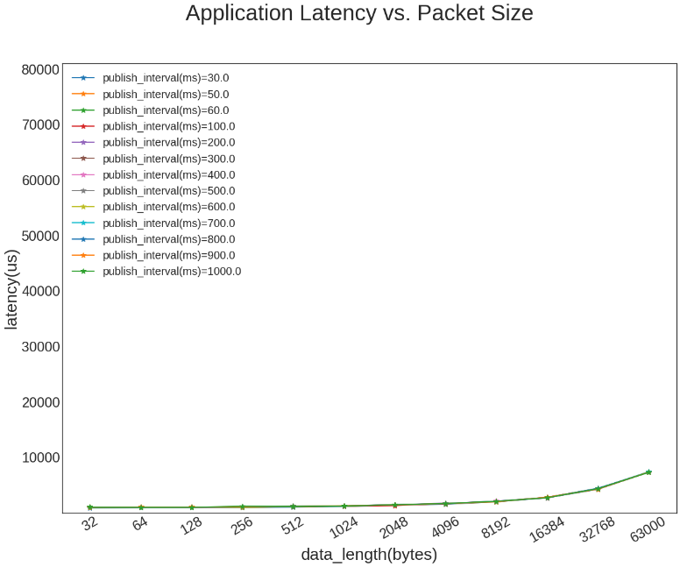
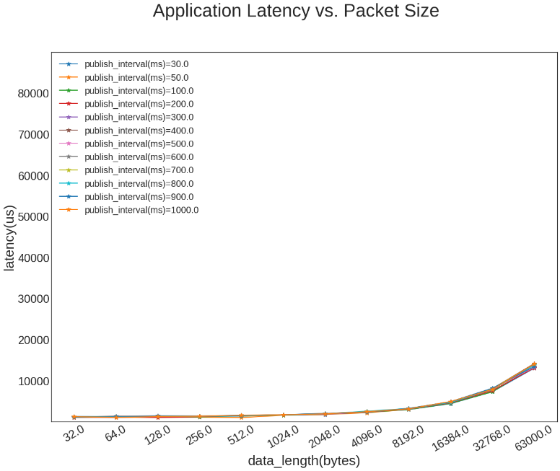
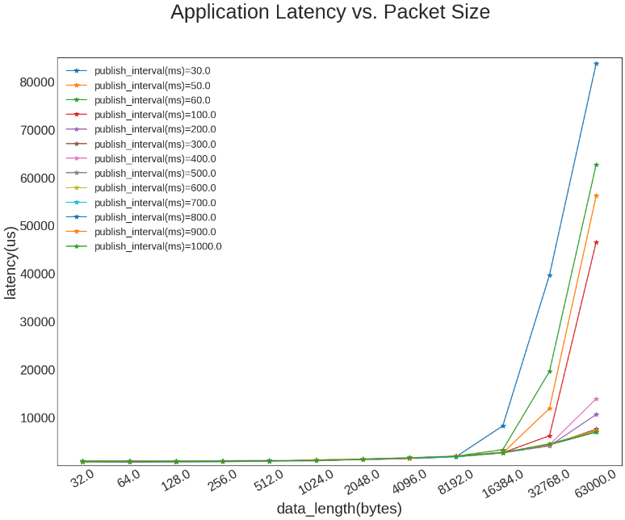
Application Latency vs Packet Size
OPC UA PubSub – UDP
MQTT – Qos0
DDS

Slide 56
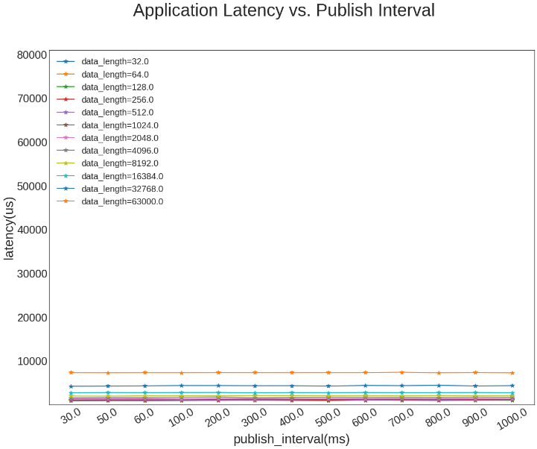
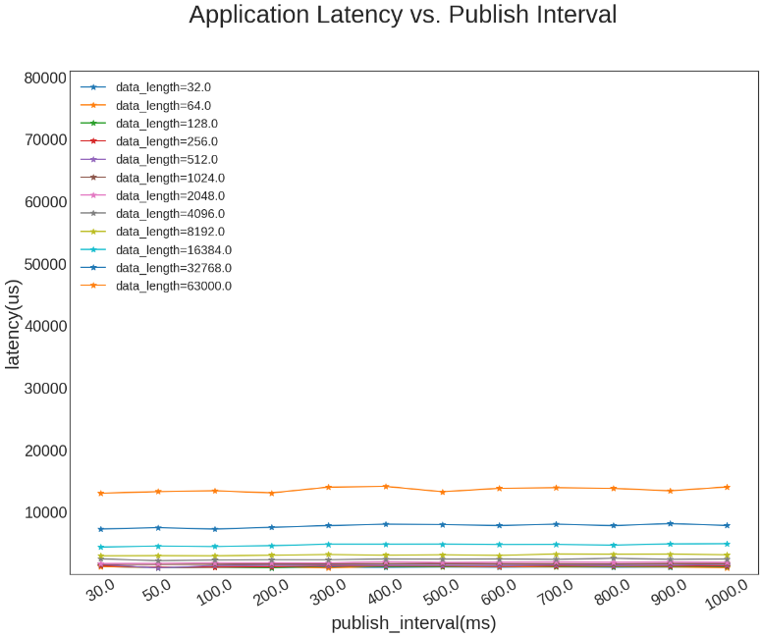
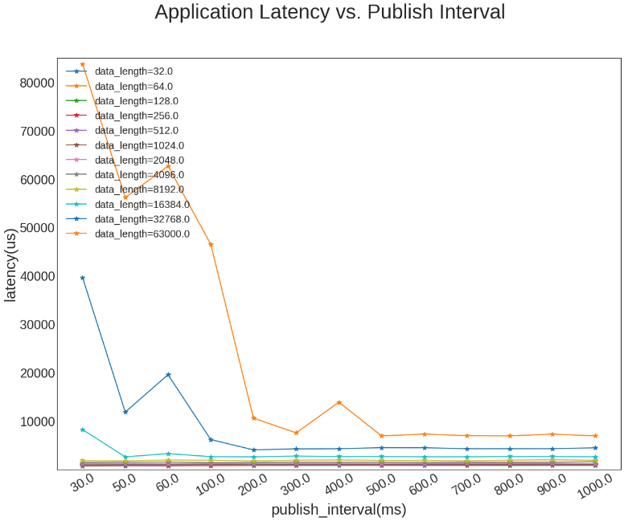
Application Latency vs Interval
OPC UA PubSub – UDP
MQTT – Qos0
DDS

Slide 57
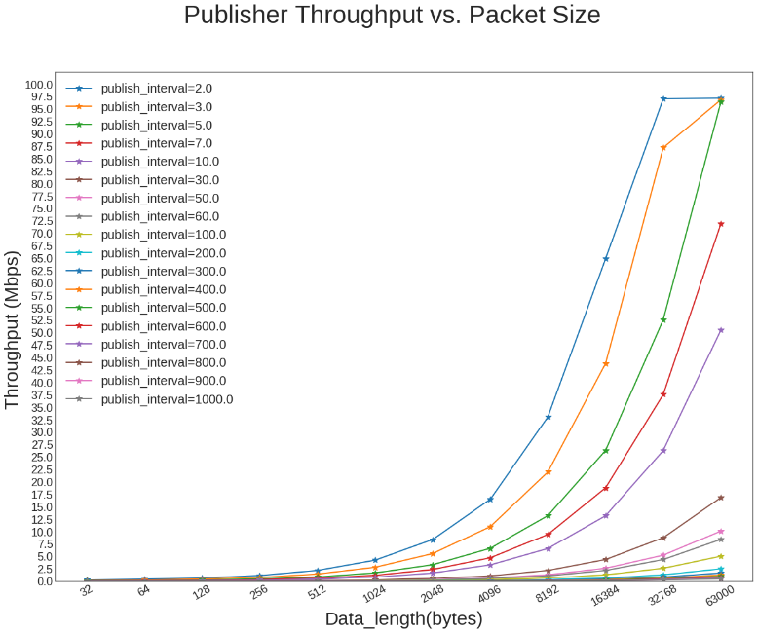
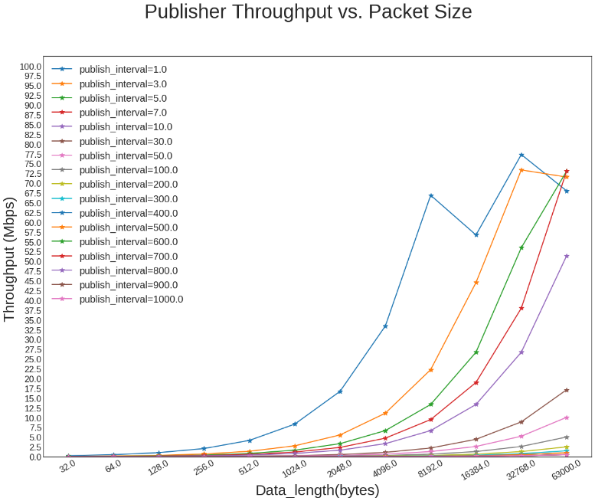
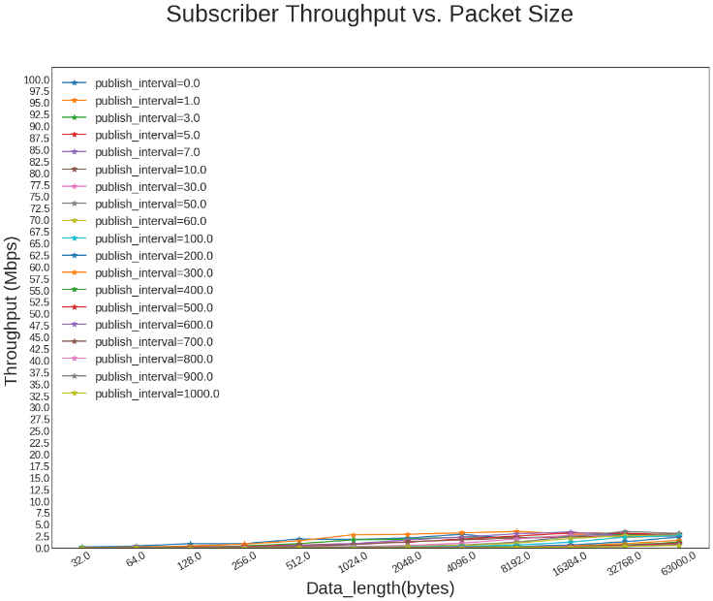
Publisher Throughput vs Packet Size (Mbps)
OPC UA PubSub – UDP
MQTT – Qos0
DDS

Slide 58
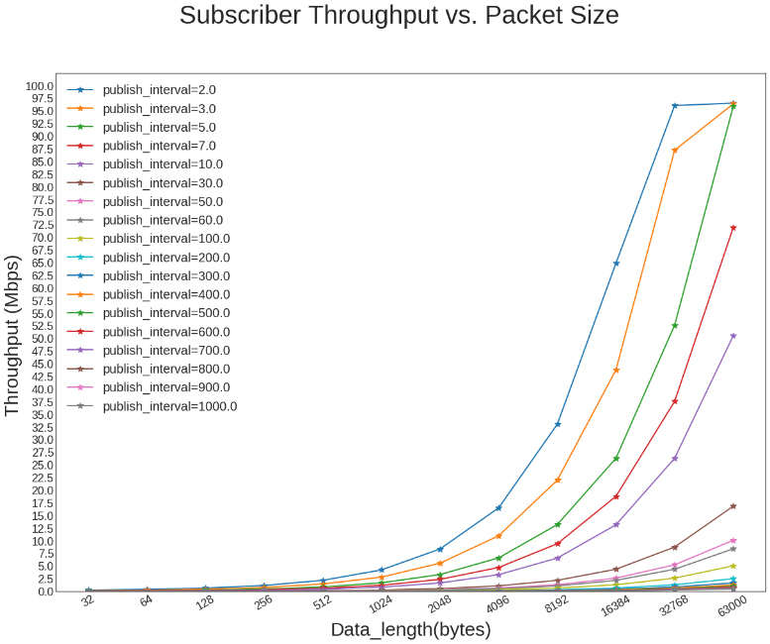

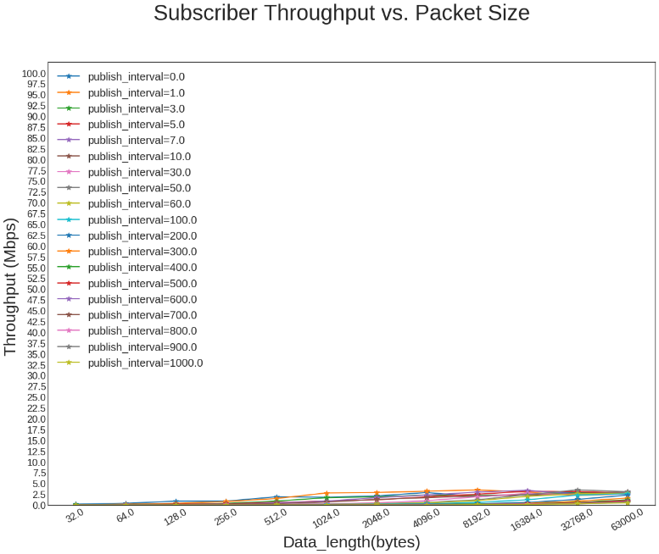
Subscriber Throughput vs Packet Size (Mbps)
OPC UA PubSub – UDP
MQTT – Qos0
DDS

Slide 59
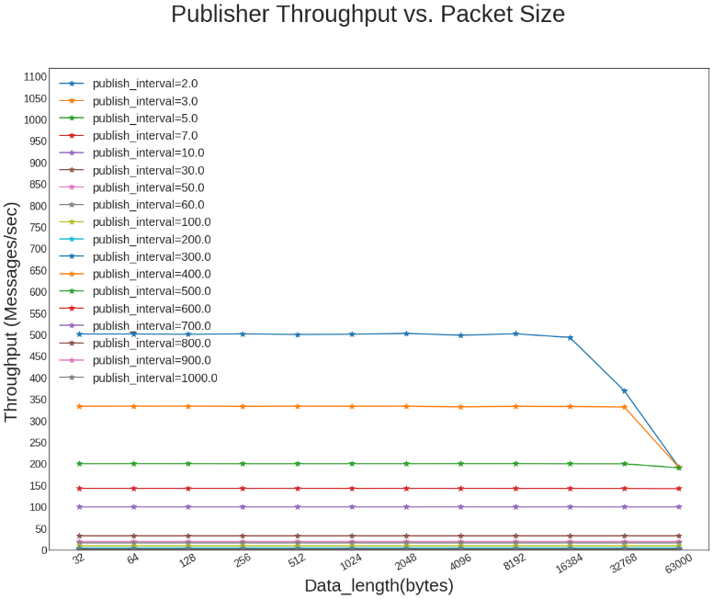
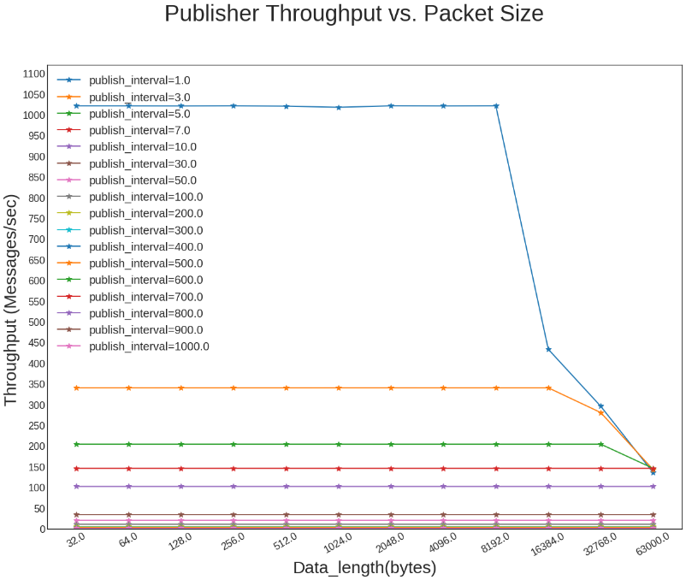
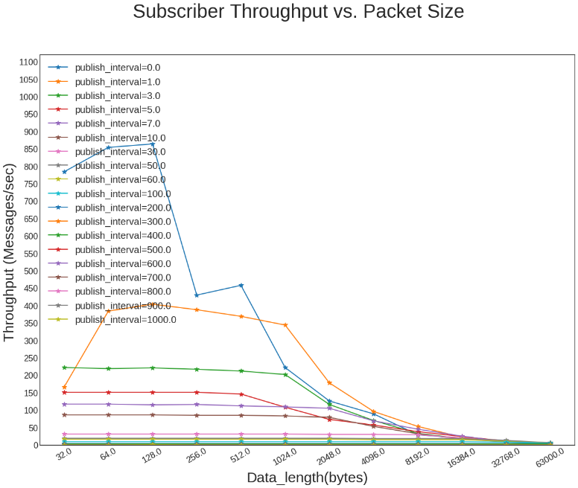
Publisher Throughput vs Packet Size (Msgs/sec)
OPC UA PubSub – UDP
MQTT – Qos0
DDS

Slide 60
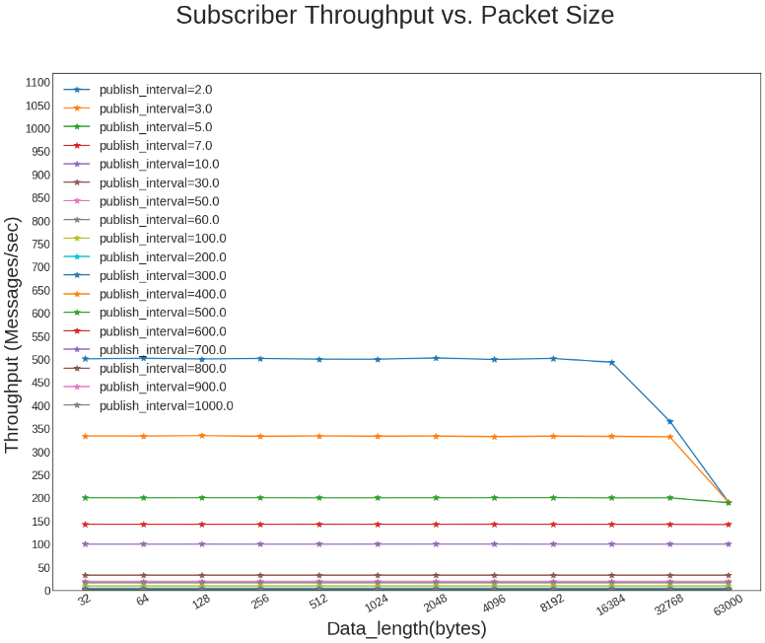
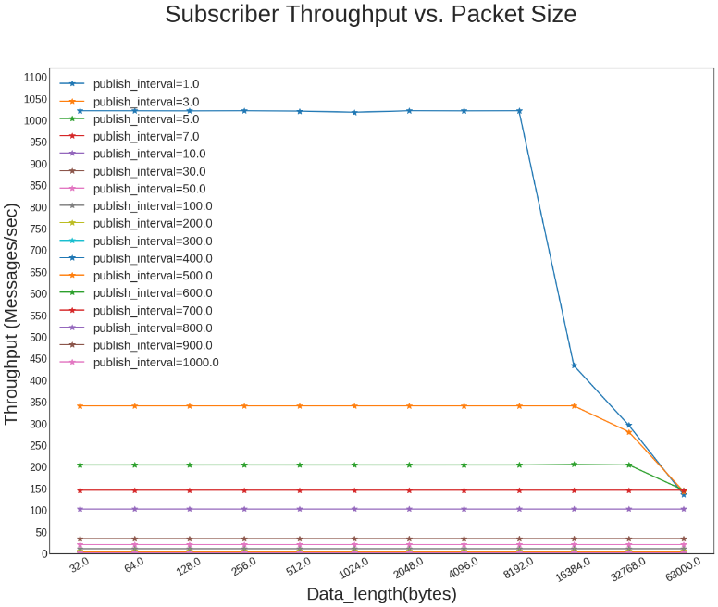
Subscriber Throughput vs Packet Size (Msgs/sec)
OPC UA PubSub – UDP
MQTT – Qos0
DDS

Slide 61
Why MRS is important?
Applications in Industrial Internet of Things can have specific characteristics
Few of these are:
Latency
Throughput
Packet Loss
Scalability
Interoperability
Dynamic Discovery
Reliability
Security
Examples here
There is no ‘one size fits all’ solution

